Slide 1


Slide 2
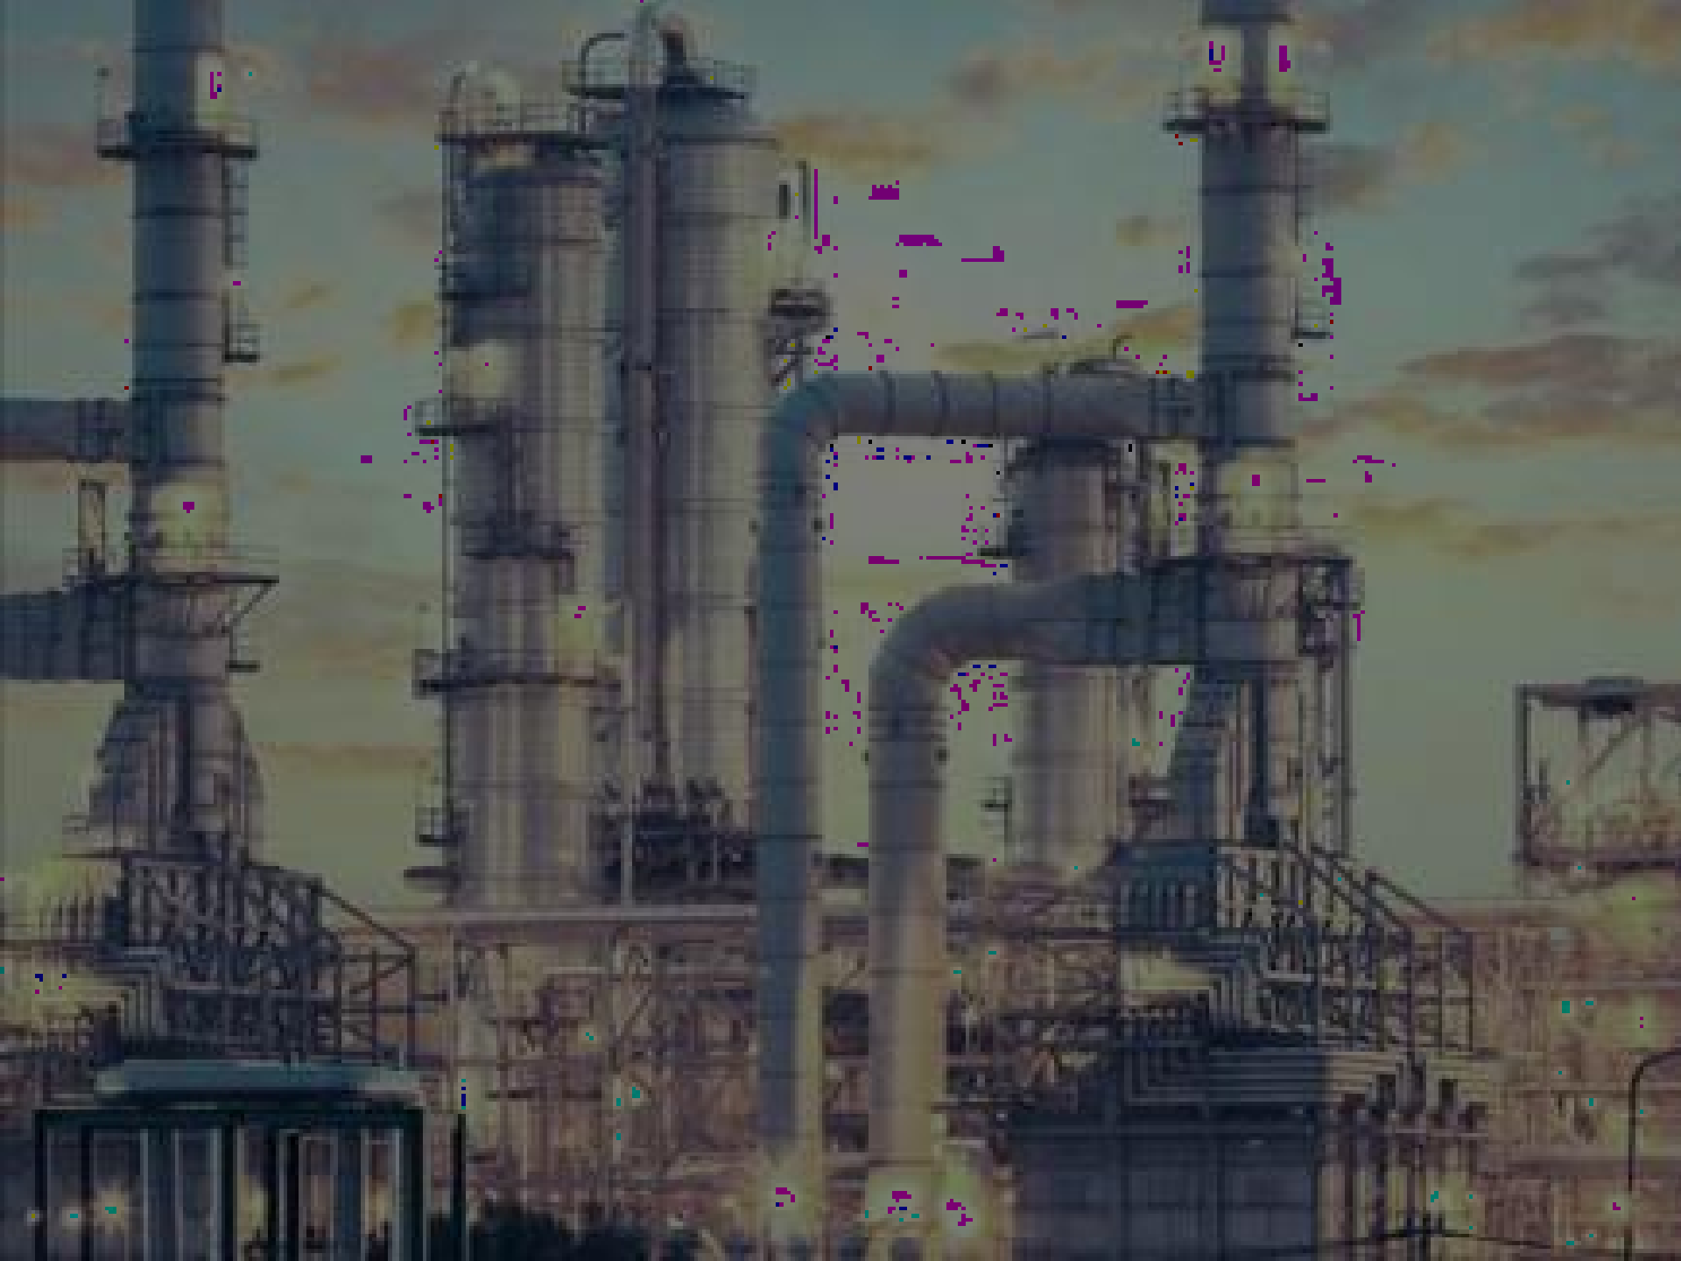
Industry
An industry is a group of firms producing products and services that are essentially the same

Slide 3

Example - Industry
Automobile industry has markets in North America, Europe and Asia

Slide 4
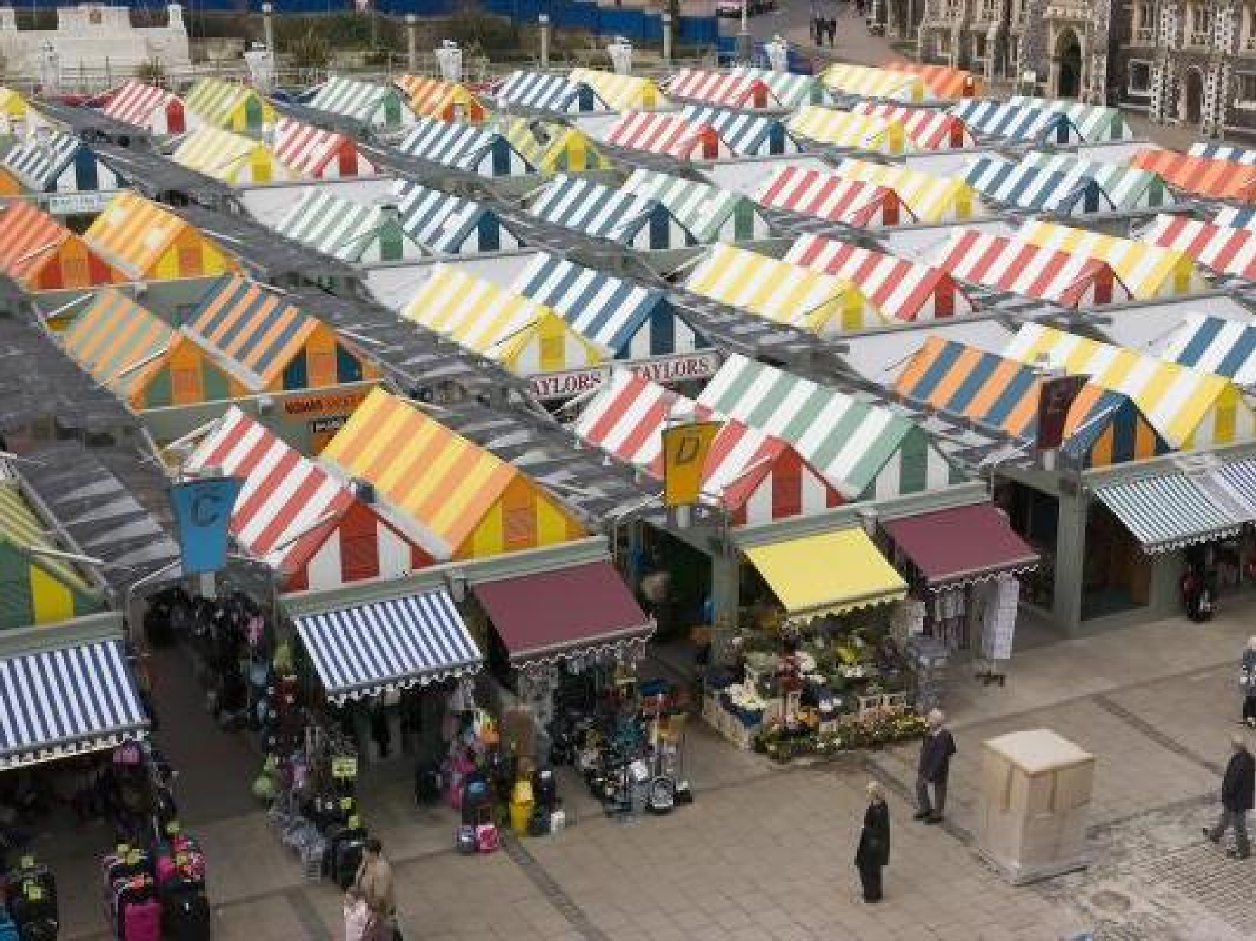
Market
A market is a group of customers for specific products or services that are essentially the same (e.g. a particular geographical market)

Slide 5
Industry Analysis

Slide 6

Porter’s Five Forces
Model
Michael Porter wrote two very Influential books
Competitive Strategy published in 1980
Competitive Advantage published in 1985

Slide 7
Michael Porter
“A company can outperform its rivals only if it can establish a difference that it can preserve over time”
A difference that is an advantage over rivals and that is sustainable

Slide 8
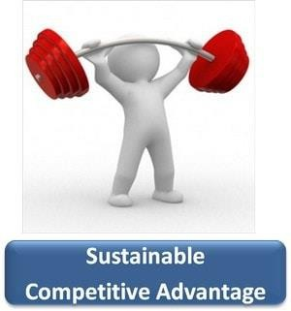
Porter’s Way of Thinking

Slide 9
Porter’s Way of Thinking
An important idea in Porter's world, is the idea of position
Porter defines Position as a set of choices that a company makes
A set of choices that one company makes will be different than a set of choices that another company makes, and therefore these companies will occupy different positions in a market or an industry

Slide 10
Porter’s Way of Thinking
Another very important idea to Michael Porter, is the idea of tradeoffs.

Slide 11
Porter’s Way of Thinking
Fit is how the choices a firm makes about what to do, interact, and support each other.
Fit is important because discrete activities often influence one another.
Fit is what makes one company's set of choices better strategically than another company's set of choices.

Slide 12
Porter’s Way of Thinking
Strategy is creating fit among a company's activities
http://www.maaw.info/ArticleSummaries/ArtSumPorter96.htm

Slide 13
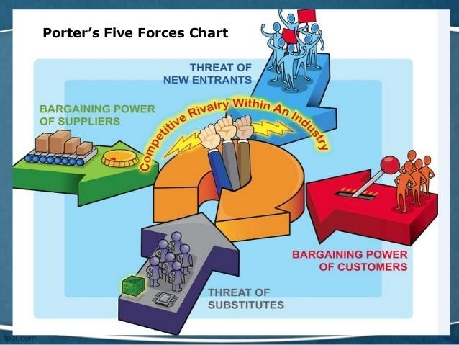

Slide 14

Competitive Rivalry

Slide 15
Competitive Rivalry
Competitive rivals are organizations aiming at the same customer groups and with similar products and services.
In the European airline industry, Air France and British Airways are rivals; high-speed trains are a ‘substitute’

Slide 16
Competitive Rivalry
5Factors tend to define the extent of rivalry in an industry or market

Slide 17
Competitive Rivalry
1
Competitor concentration and balance
Where competitors are numerous or of roughly equal size or power there is the danger of intensely rivalrous behavior as competitors attempt to gain dominance over others, through aggressive price cuts
Examples in Pakistani Context?

Slide 18
Competitive Rivalry
2
Industry growth rate
In situations of strong growth, an organization
can grow with the market, but in situations of
low growth or decline, any growth is likely to
be at the expense of a rival.
Low-growth markets are therefore often
associated with price competition and low
profitability

Slide 19
Competitive Rivalry
3
High fixed costs
Industries with high fixed costs, perhaps
because they require high investments in
capital equipment or initial research, tend to
be highly rivalrous
Companies will seek to spread their costs (i.e.
reduce unit costs) by increasing their
volumes: to do so, they typically cut their
prices, prompting competitors to do the same
and thereby triggering price wars in which
everyone in the industry suffers

Slide 20
Competitive Rivalry
3
High fixed costs
Similarly, if extra capacity can only be added in large increments (as in many manufacturing sectors, for example a chemical or glass factory), the competitor making such an addition is likely to create short-term over-capacity in the industry, leading to increased competition to use capacity
A Case of Automobile Industry in Pakistan?

Slide 21
Competitive Rivalry
4
High exit barriers
Exit barriers might be high for a variety of reasons: for example, high redundancy costs or high investment in specific assets such as plant and equipment which others would not buy

Slide 22
Competitive Rivalry
5
Low differentiation
In a commodity market, where products or services are poorly differentiated, rivalry is increased because there is little to stop customers switching between competitors and the only way to compete is on price.
Example: Petrol is a commodity market

Slide 23
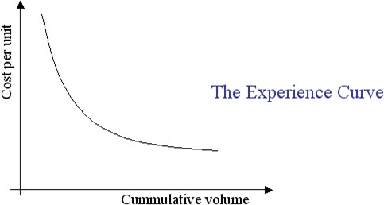
The Threat of Entry
1
Scale and Experience
In some industries, economies of scale are extremely important: for example, in the production of automobiles or the advertising of fast-moving consumer goods

Slide 24
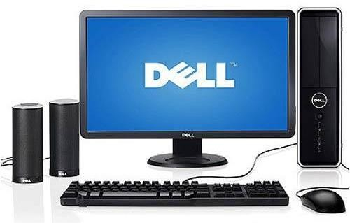

The Threat of Entry
2
Access to supply or distribution channels
In many industries manufacturers have had control over supply and/or distribution channels

Slide 25
The Threat of Entry
3
Legislation or government action
Legal restraints on new entry vary from patent protection (e.g. pharmaceuticals) to direct government action (e.g. tariffs)

Slide 26

The Threat of Substitutes

Slide 27
The Threat of Substitutes
Substitutes are products or services that offer the same or a similar benefit to an industry’s products or services.
For example, aluminum is a substitute for steel; a tablet computer is a substitute for a laptop
Managers often focus on their competitors in their own industry, and neglect the threat posed by substitutes.

Slide 28
The Threat of Substitutes
1
The price/performance ratio is critical to substitution threats
A substitute is still an effective threat even if more
expensive, so long as it offers performance advantages that
customers value
Aluminum is more expensive than steel, but its relative
lightness and its resistance to corrosion gives it an
advantage in some automobile manufacturing applications.
It is the ratio of price to performance that matters, rather
than simple price

Slide 29
The Threat of Substitutes
2
The value of the substitution concept is to force managers to look outside their own industry to consider more distant threats and constraints.
If the buyers’ switching costs for the substitute are low the threat increases and the higher the threat, the less attractive the industry is likely to be

Slide 30
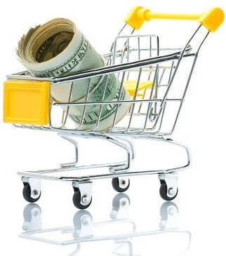
The Power of Buyers

Slide 31

The Power of Buyers
Buyers are the organization's immediate customers. If buyers are powerful, then they can demand low prices or costly product or service improvements

Slide 32
The Power of Buyers
1
Concentrated Buyers
Where a few large customers account for the majority of sales, buyer power is increased. This is the case for items such as milk in the grocery sector in many European countries, where just a few retailers dominate the market

Slide 33
The Power of Buyers
1
Concentrated Buyers
If a product or service accounts for a high percentage of total purchases of the buyer their power is also likely to increase as they are more likely to ‘shop around’ to get the best price.

Slide 34
The Power of Buyers
2
Low Switching Costs
Where buyers can easily switch between one supplier and another, they have a strong negotiating position and can squeeze suppliers who are desperate for their business.

Slide 35
The Power of Buyers
2
Low Switching Costs
Switching costs are typically low for standardized and undifferentiated products like commodities such as steel. They are also likely to be low when the buyers are fully informed about prices and product performance

Slide 36
The Power of Buyers
3
Buyer Competition Threat
If the buyer has the capability to supply itself, or if it has the possibility of acquiring such a capability, it tends to be powerful. In negotiation with its suppliers,
it can raise the threat of doing the suppliers’ job themselves
Example: Some steel companies have gained power over their iron ore suppliers as they have acquired iron ore sources for themselves

Slide 37
Important to Remember
It is very important that buyers are distinguished from consumers.
Thus for companies like Procter & Gamble or Unilever (makers of shampoo, washing powders and so on), their buyers are retailers such as Carrefour or Tesco, not ordinary consumers. Carrefour and Tesco have much more negotiating power than an ordinary consumer would have.

Slide 38
Important to Remember
The high buying power of such supermarkets is a strategic issue for the companies supplying them. It is often useful therefore to distinguish ‘strategic customers’, powerful buyers (such as the retailers) towards whom the strategy should be primarily orientated.
In the public sector, the strategic customer is typically the provider of funds, rather than the consumer of services: for a pharmaceutical company, the strategic customer is the hospital, not the patient

Slide 39
Thank you

